Slide 1
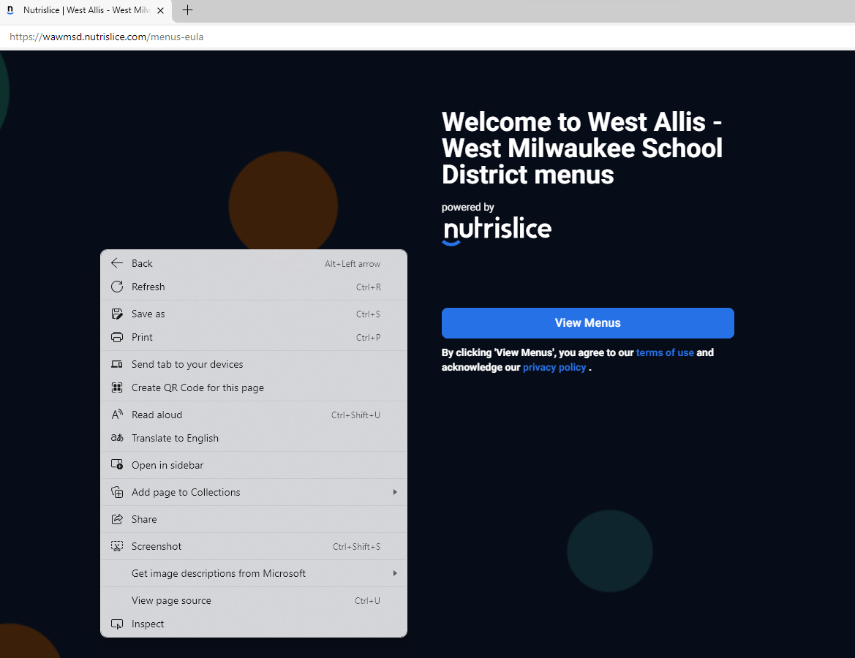
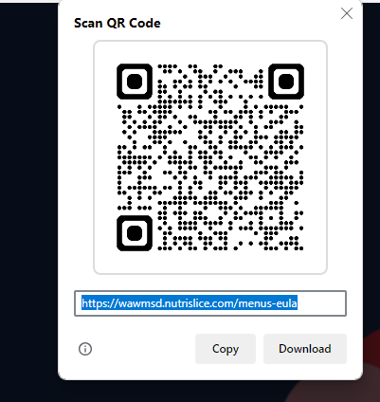
Instructions to Customize Your Newsletter:
EVERY MONTH
Add your district name and logo to the header
Add DDS photo and contact info to bottom of first page
Write short blurbs in the copy placeholders on front and back page (use Copilot if you need help)
Add photos in photo placeholders. Careful NOT to stretch photos.
First page: one showcase pic (people, events, food)
Back page/middle: A fun day photo or people photo to match copy
Back page/bottom: Review or replace existing fun days images
Delete this page, spell check and proofread (use Copilot)
SAVE as PDF and share. Do NOT share the PowerPoint version.
Read ALL instructions first!
DELETE this page when done!
Pro Tips
PHOTOS
USE the photo placeholders (click icon to add picture), select a photo you have saved to your files. If you need to adjust the size or zoom in: Click on the pic > Picture format (top menu bar) > drop down menu under Crop > Fill > click on the edges of the pic to drag it smaller, larger, adjust up or down
QR CODES
Create engagement and utility with a QR code next to online menus, surveys, links to F&R apps etc
Generate a QR code easily directly from your browser. Recommend Microsoft Edge browser, PC instructions:
Visit the web page you want to link to
Right click anywhere on the page, a pop-up like image below
Click “Create QR code for this page”, a pop-up QR code appears
Copy and paste QR code into your newsletter
You may similarly use Google Chrome or a free service like www.QRcode-monkey.com

Slide 2

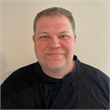
Dallas Center-Grimes Food Services Newsletter
April 2026
Strengthening Our Team: Introducing a New Lead at Dallas Center Middle School
Chartwells is excited to share that a new lead, Audra, will be taking over the kitchen at Dallas Center Middle School. Audra is a wonderful addition to our team and brings a wide range of strengths and valuable experience to this role. She is especially excited to join this district due to her personal ties to the community and her passion for serving the students at DC Middle School. With years of food service experience, students can look forward to excellent service and a friendly, welcoming face each day.
A Look Into Seasonings and Pesto
April is all about being a Waste Warrior, and Chef Jozsef helped lead the way by showing students how to reduce food waste through a simple, homemade pesto demonstration. He highlighted how easy it is to create a tasty sauce using ingredients found around the house, including produce that may not look appealing. Students learned that these “imperfect” fruits and vegetables are just as flavorful and nutritious, and that over 6 million pounds of food waste comes from produce discarded for appearance alone. This pesto lesson demonstrated how using all vegetables, no matter how they look, can reduce waste and encourage appreciation for all foods.
Matt Pasma
DIRECTOR OF DINING SERVICES
515-423-6356
Matthew.Pasma@COMPASS-USA.COM

Slide 3








DISCOVERY KITCHEN FUN
Be A Waste Warrior
This month’s Discovery Kitchen theme presents interactive, impactful activities to connect with today’s students. With environment-friendly festivities including Earth Day and Stop Food Waste Day throughout the month of April, we’ll celebrate with featured foods and programs that highlight the many ways students and the community can make a difference in reducing food waste and protect the environment.
Optional logos for story #2
Prom-otion
This month, we were excited to offer high school students a fun Prom‑otion giveaway to help cover prom dinner costs. Students had the chance to win a $100 or $50 gift card, and participation was open to all grade levels, including freshmen and sophomores, to use at their favorite restaurants. When students purchased a full school lunch, they were eligible to enter their name into the drawing. The giveaway ran for eight days, and students could enter once per day, giving them multiple chances to win. We loved adding a little extra excitement to prom season and supporting students along the way!
UP NEXT:
Elementary students are being offered raisins to participate in raisin day!
The Earth is always something worth celebrating. Happy Earth Day!
DCG is fortunate to have outstanding libraries led by even better librarians. Thank you!
Optional Fun Days (link here)
This institution is an equal opportunity provider.

